Slide 1

RNN
Teoh Teik Toe
ITOM/NBS
ttteoh@ntu.edu.sg
97905202

Slide 2
Supervised Learning
Classifier
Deep Learning

Slide 3
Deep Learning
Temporal
Sequence
Time Series
HMM, RNN, LSTM (depends on length of sequence and complexity of data)

Slide 4

Keras
Keras is an open-source neural-network library written in Python.
Its primary author and maintainer is François Chollet, a Google engineer.
In 2017, Google's TensorFlow team decided to support Keras in TensorFlow's core library.

Slide 5

TensorFlow
TensorFlow is a free and open-source software library. It is a symbolic math library and is also used for machine learning applications such as neural networks.
TensorFlow was developed by the Google Brain team for internal Google use.
It was released under the Apache License 2.0 on November 9, 2015.

Slide 6
RNN Definition
Temporal sequence
Dynamic behavior
Use internal state (memory) to process sequences of inputs.
Handwriting recognition or speech recognition.

Slide 7
RNN Application
Handwriting recognition
Speech recognition
Robot control
Time series prediction
Time series anomaly detection
Human action recognition
Anomaly detection in network traffic
IDS's (intrusion detection systems)

Slide 8
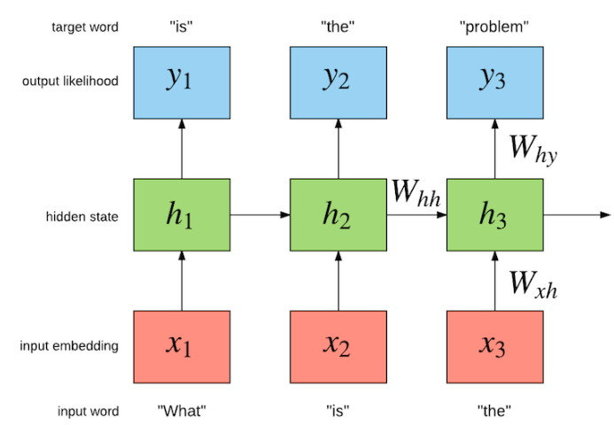
RNN : Prediction & Classification, Long Sequence

Slide 9
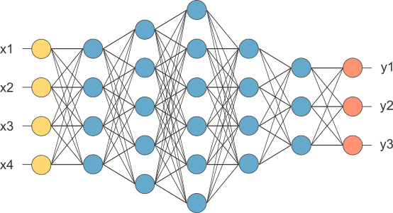
MLP
This is our fully connected network. If x_{1 .}... x_{n}, n is very large and growing,
this network would become too large. We now will input one x_{i} at a time,
and re-use the same edge weights.

Slide 10
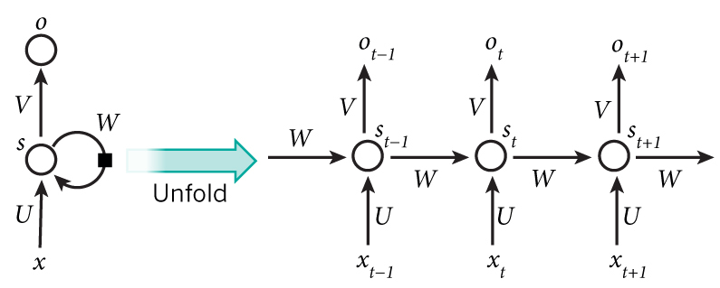
Recurrent Neural Network

Slide 11
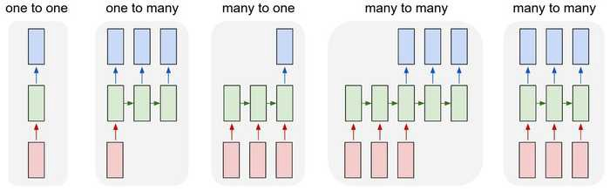
RNN

Slide 12
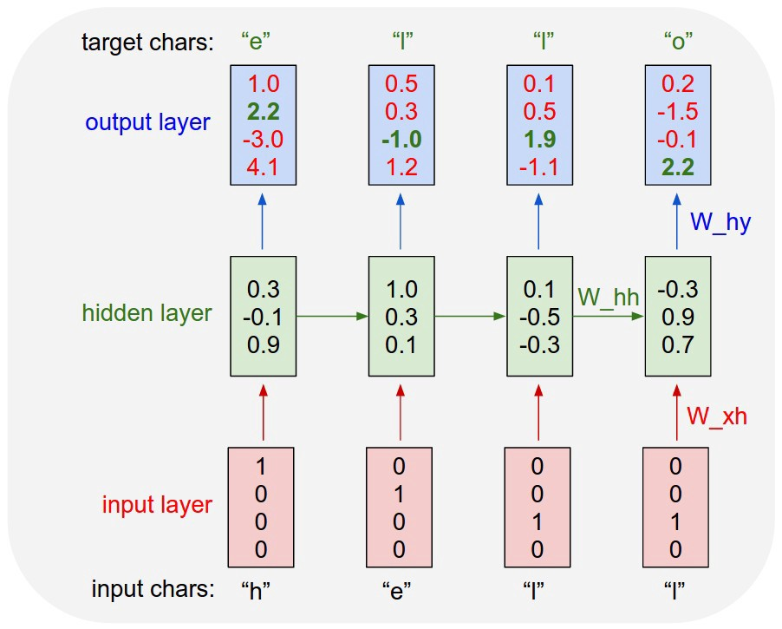
Many to One example

Slide 13
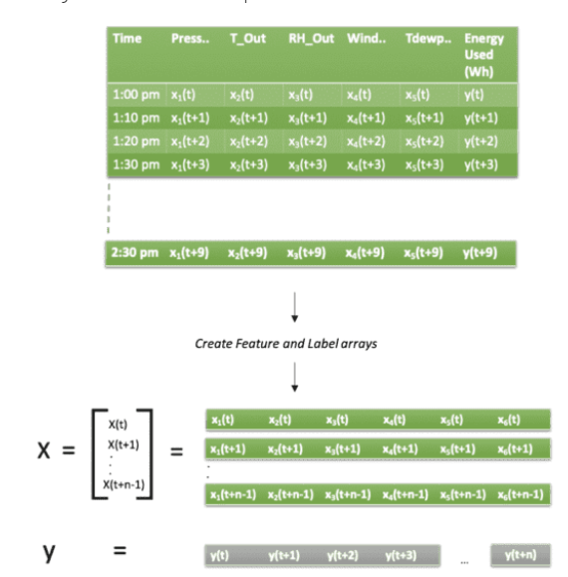
Data Structure for LSTM

Slide 14
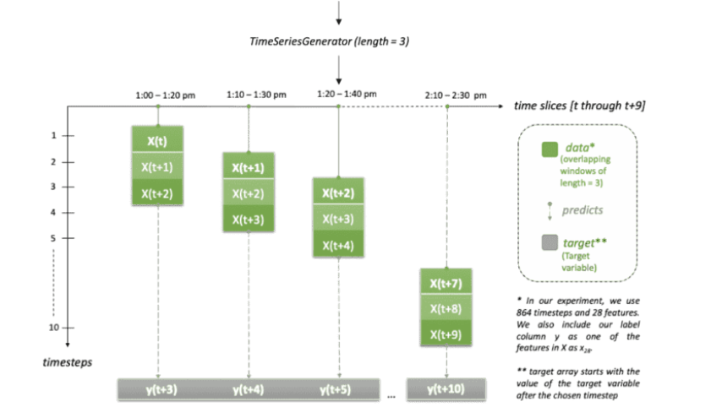

Slide 15
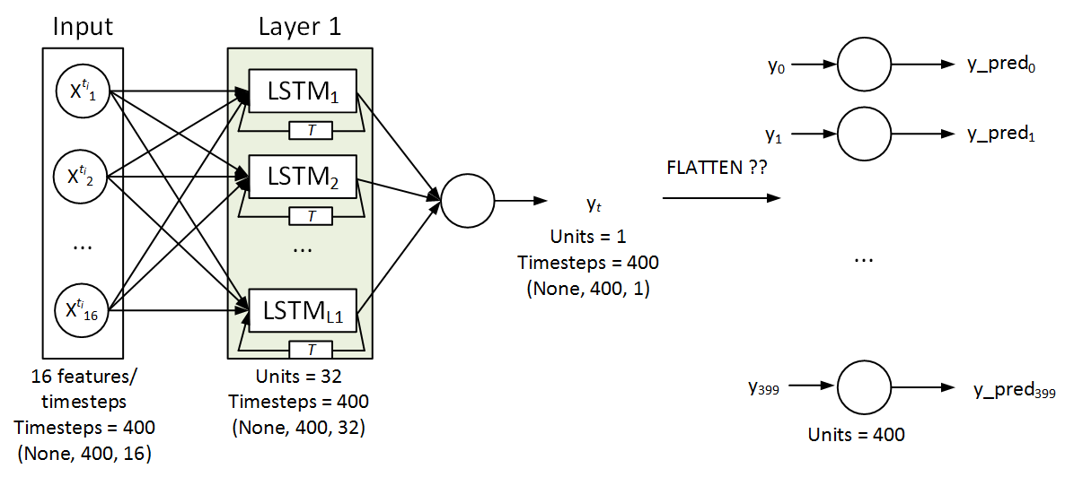
LSTM + MLP

Slide 16
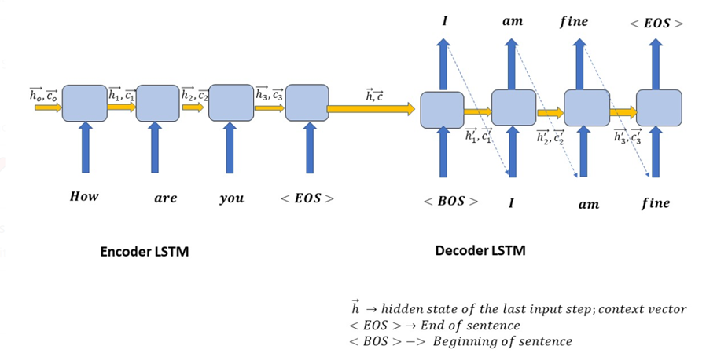
Sequence to Sequence Concept

Slide 17

How does it work?

Slide 18




Example
Input sequence:
$$\left[\begin{aligned}1 \\ 1\end{aligned}\right]$$
$$\left[\begin{aligned}1 \\ 1\end{aligned}\right]$$
$$\left[\begin{aligned}2 \\ 2\end{aligned}\right]$$
$$……$$
output sequence:
??????
store
given Initial values
0
0
All the weights are “1”, no bias
All activation functions are linear
Pass the output directly with dot product
1
1

Slide 19
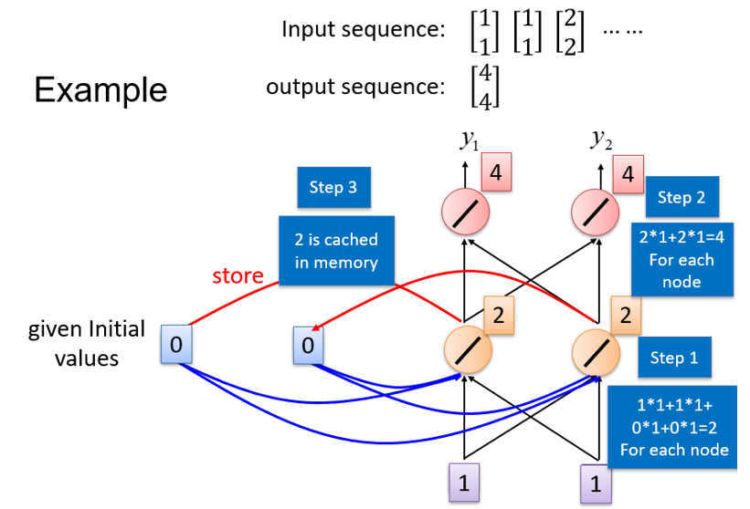

Slide 20
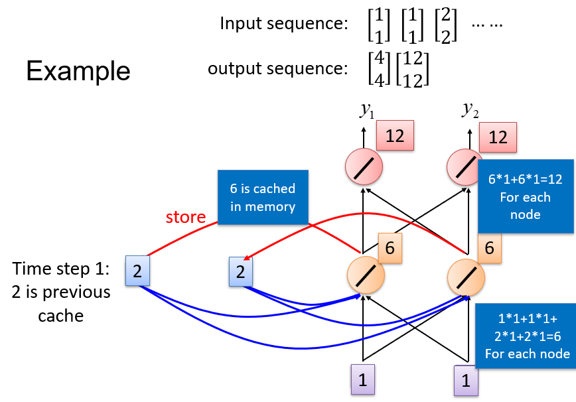

Slide 21
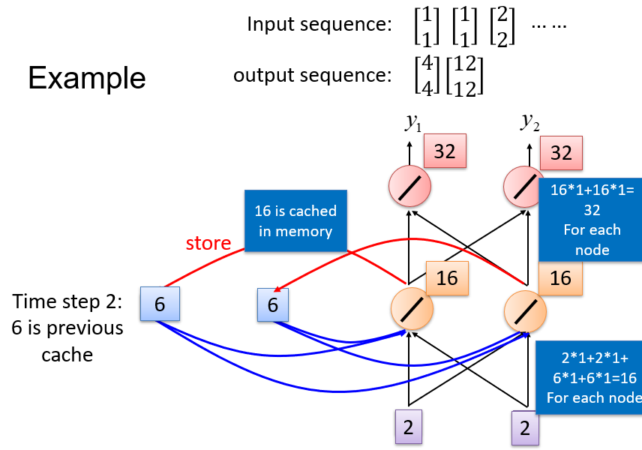

Slide 22
Problems with RNN
When dealing with a time series, it tends to forget old information. When there is a distant relationship of unknown length, we wish to have a “memory” to it.
Vanishing gradient problem.
Solution : LSTM

Slide 23
LSTM and How to train them?

Slide 24
Long Short-term Memory (LSTM)
Other part of the network
Signal control the output gate
Output Gate
(Other part of the network)
Memory
Cell
Forget Gate
Signal control the forget gate
(Other part of the network)
Signal control the input gate
Input Gate
LSTM
(Other part of the network)
Other part of the network
Notes:
Normal neuron
1 input, 1 output
This one
4 input, 1 output

Slide 25
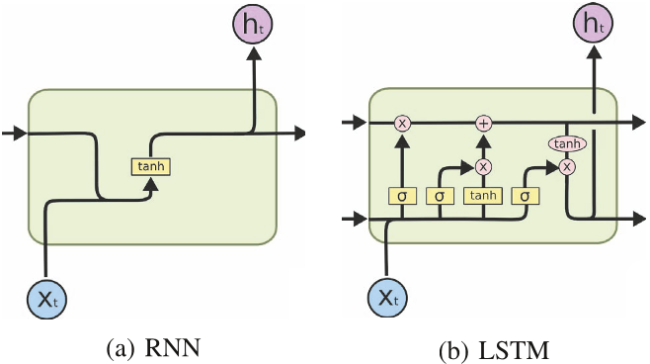
RNN vs LSTM
Input Gate Forget gate Output Gate

Slide 26
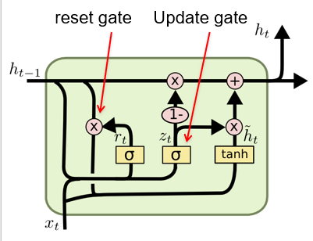
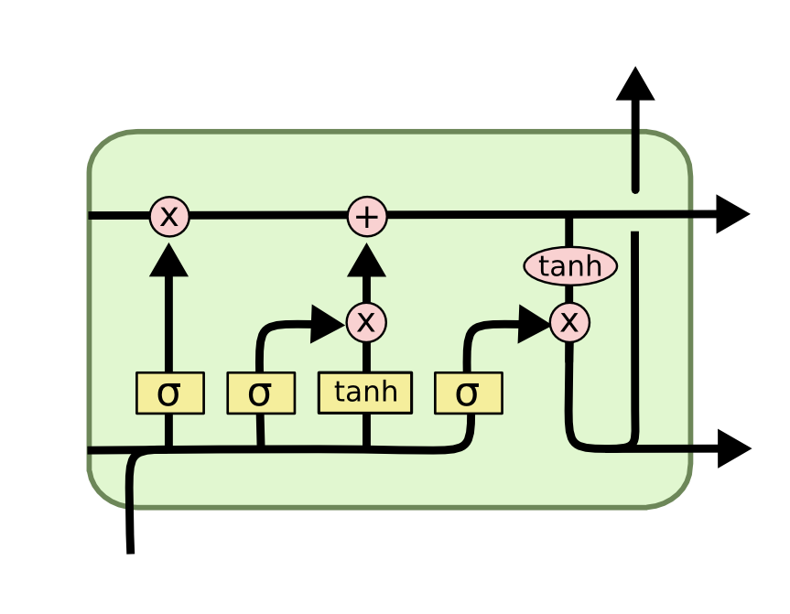
GRU – gated recurrent unit (more compression)
LSTM
It combines the forget and input into a single update gate.
It also merges the cell state and hidden state. This is simpler
than LSTM. There are many other variants too.
X,*: element-wise multiply

Slide 27
Code example for LSTM / RNN

Slide 28
Python Code
import pandas as pd
df = pd.read_csv("CyberSecurity.csv")
print(df.columns)
print(df.head())
# feature selection
from sklearn.feature_selection import SelectKBest, chi2
X1 = df.iloc[:, :-1]
Y1 = df.iloc[:, -1]
features = SelectKBest(score_func=chi2, k=5)
fit = features.fit(X1, Y1)
print(df.columns, fit.scores_)
mask = fit.get_support()
new_features = X1.columns[mask]
print(new_features[:])

Slide 29
timesteps = 1
df_size = len(df)
df_resize = int(df_size//timesteps)
df_trunc_size = df_resize * timesteps
num_class = 1 #many to one, change to 1. for many to many, change to timesteps
X = df.loc[:, [' MV101', 'P102', 'AIT202']]
df_dim = len(X.columns)
X = X.values
Y = df.loc[:, ["Attack"]].values
X = X[:df_trunc_size, :]
Y = Y[:df_trunc_size]
X_shaped = X.reshape(df_resize, timesteps, df_dim)
Y_shaped = Y.reshape(df_resize, timesteps)
print(X_shaped.shape)
Y_shaped = Y_shaped[:,-1] # because many to 1, we only select the last
from sklearn.model_selection import train_test_split
X_train,X_test, Y_train, Y_test = train_test_split(X_shaped,Y_shaped)
from keras.models import Sequential
from keras.layers import Dense, Dropout, LSTM, SimpleRNN, GRU

Slide 30
RNN
model1 = Sequential()
model1.add(SimpleRNN(12, return_sequences=True, input_shape=(timesteps, df_dim)))
model1.add(Dropout(0.2))
model1.add(SimpleRNN(12, return_sequences=True))
model1.add(Dropout(0.2))
model1.add(SimpleRNN(12))
model1.add(Dropout(0.2))
#change 1 to num_class for many to many
model1.add(Dense(1, activation='sigmoid'))
model1.summary()
model1.compile(loss='binary_crossentropy', optimizer='rmsprop', metrics=['accuracy'])
model1.fit(X_train, Y_train, batch_size=10, epochs = 10)

Slide 31
Predict
pred = model1.predict(X_test)
pred = pred > 0.5
pred = pred.reshape(pred.shape[0]*pred.shape[1])
print(pred)
actual = Y_test.reshape(Y_test.shape[0])
print(actual)
from sklearn.metrics import confusion_matrix
cm = confusion_matrix(actual, pred)
print(cm)
accuracy = (cm[0,0] + cm[1,1])/sum(sum(cm))
print(accuracy)

Slide 32
GRU
model2= Sequential()
model2.add(GRU(12, return_sequences=True, input_shape=(timesteps, df_dim)))
model2.add(Dropout(0.2))
model2.add(GRU(12,return_sequences=True))
model2.add(Dropout(0.2))
model2.add(GRU(12))
model2.add(Dropout(0.2))
#change 1 to num_class for many to many
model2.add(Dense(1, activation='sigmoid'))
model2.summary()
model2.compile(loss='binary_crossentropy', optimizer='rmsprop', metrics=['accuracy'])
model2.fit(X_train, Y_train, batch_size=10, epochs = 10)

Slide 33
Predict
pred = model2.predict(X_test)
pred = pred > 0.5
pred = pred.reshape(pred.shape[0]*pred.shape[1])
print(pred)
actual = Y_test.reshape(Y_test.shape[0])
print(actual)
from sklearn.metrics import confusion_matrix
cm = confusion_matrix(actual, pred)
print(cm)
accuracy = (cm[0,0] + cm[1,1])/sum(sum(cm))
print(accuracy)

Slide 34
LSTM
model3 = Sequential()
#use_bias https://keras.io/api/layers/recurrent_layers/lstm/
model3.add(LSTM(11, return_sequences = True, input_shape = (timesteps, df_dim)))
model3.add(Dropout(0.1))
model3.add(LSTM(12, return_sequences = True))
model3.add(Dropout(0.1))
model3.add(LSTM(10, return_sequences = True))
model3.add(Dropout(0.1))
model3.add(LSTM(10)) # last layer no return sequence, no memory
model3.add(Dropout(0.1))
model3.add(Dense(num_class, activation = "sigmoid"))
model3.summary()
model3.compile(loss='binary_crossentropy', optimizer='rmsprop', metrics=['accuracy'])
model3.fit(X_train, Y_train, batch_size=10, epochs=10)

Slide 35
Predict
pred = model3.predict(X_test)
pred = pred > 0.5
pred = pred.reshape(pred.shape[0]*pred.shape[1])
print(pred)
actual = Y_test.reshape(Y_test.shape[0])
print(actual)
from sklearn.metrics import confusion_matrix
cm = confusion_matrix(actual, pred)
print(cm)
accuracy = (cm[0,0] + cm[1,1])/sum(sum(cm))
print(accuracy)

Slide 36
Exercise
Please try to design your own LSTM.
You need to change the layer of neurons and number of neurons.

Slide 37
Summary
Learn how to
How to define neural network in Keras.
How to compile a Keras model using the efficient numerical backend.
How to train a model on data.
How to evaluate a model on data.
How to predict the test data.

Slide 38
Thank You

